Slide 1
Phylogenetic analyses
Kirsi Kostamo

Slide 2
The aim:
To construct a visual representation (a tree) to describe the assumed evolution occurring between and among different groups (individuals, populations, species, etc.) and to study the reliability of the consensus tree.

Slide 3
Assumptions
Evolution produces dichotomous branching
Evolution is simple – the best explanation assumes least mutations

Slide 4
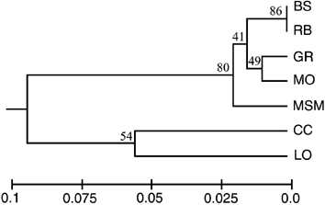
A phylogeographic tree is a mathematical model of evolution

Slide 5
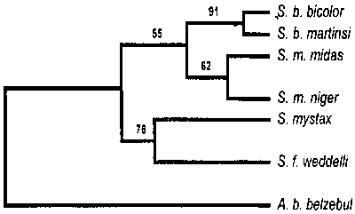
Parts of a phylogenetic tree
Branch
Node
Root
Ingroup
Outgroup

Slide 6
Tree structure
A tree can be also presented in a text format: (A(B(C,D)))
The graphic structure can be difficult to interpret (2-dimentional)

Slide 7
Analyses
Choosing the sequence type
Alignment of sequence data
Search for the best tree
Evaluation of tree reproducibility

Slide 8
Analyses can be based on:
Differences in DNA-sequence structure
Distance matrix between sequences
Restriction data
Allele data

Slide 9
Methods
Distance matrix
Maximum parsimony
Minimum distance

Slide 10
Distance matrix
A distance matrix is calculated from the sequence dataset
Algorithms: Fitch-Margoliash, Neighbor-Joining or UPGMA in tree building
Simple, finds only one tree
Somewhat old-fashioned (OK if your alignment is good and evolutionary distances are short)

Slide 11
Maximum parsimony
Finds the optimum tree by minimizing the number of evolutionary changes
No assumptions on the evolutionary pattern
May oversimplify evolution
May produce several equally good trees

Slide 12
Maximum likelihood
The best tree is found based on assumptions on evolution model
Nucleotide models more advanced at the moment than aminoacid models
Programs require lot of capacity from the system

Slide 13
Algorithms used for tree searching
Exhaustive search: all possibilities → best tree → requires lots of time and computer resources
Branch and Bound: a tree is built according to the model given → the tree is compared to the next tree while its constructed → if the first tree is better the second tree is abandoned → third tree… → best possible tree
Heuristic Search: only the most likely options → saves time and resources, does not always result in the best tree

Slide 14
Bootstrapping
Evaluation of the tree reliability
n number of trees are built (n=100/1000/5000)
→ How many times a certain branch is reproduced
Values between 1-100 (%)

Slide 16
Programs in sequence analyses
Kirsi Kostamo

Slide 17
Programs
Most programs freeware – can be obtained from the internet
Designed to address particular questions – generally you need several small programs for the whole analysis
Lots of bugs and restrictions
Use Notepad/Textpad if you need to open the files at any time

Slide 18
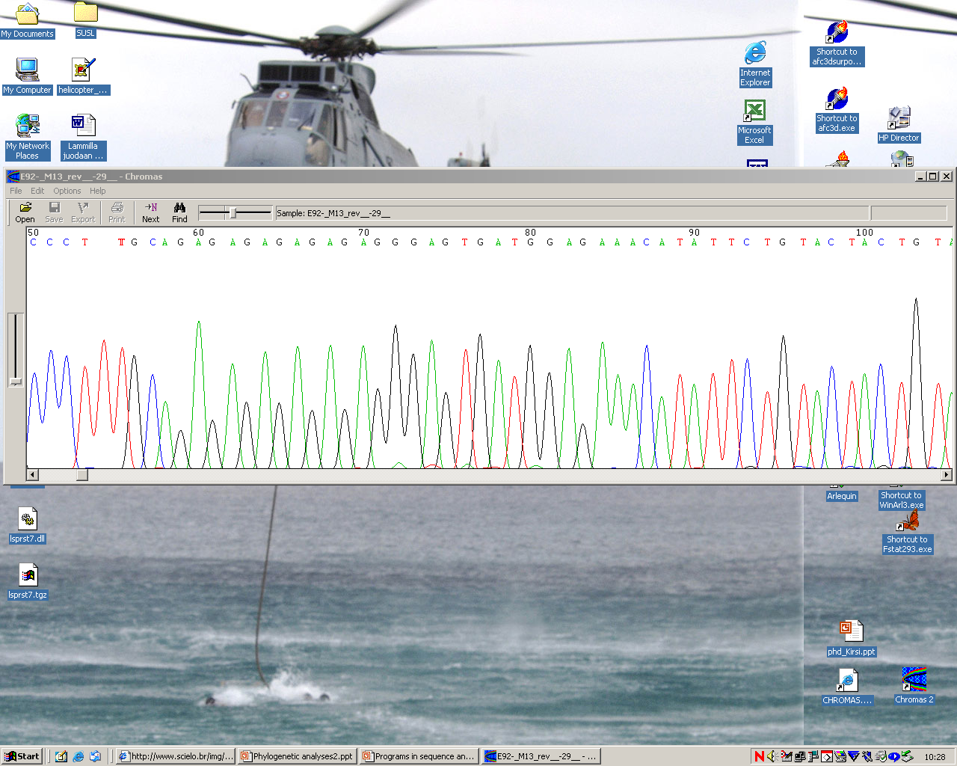
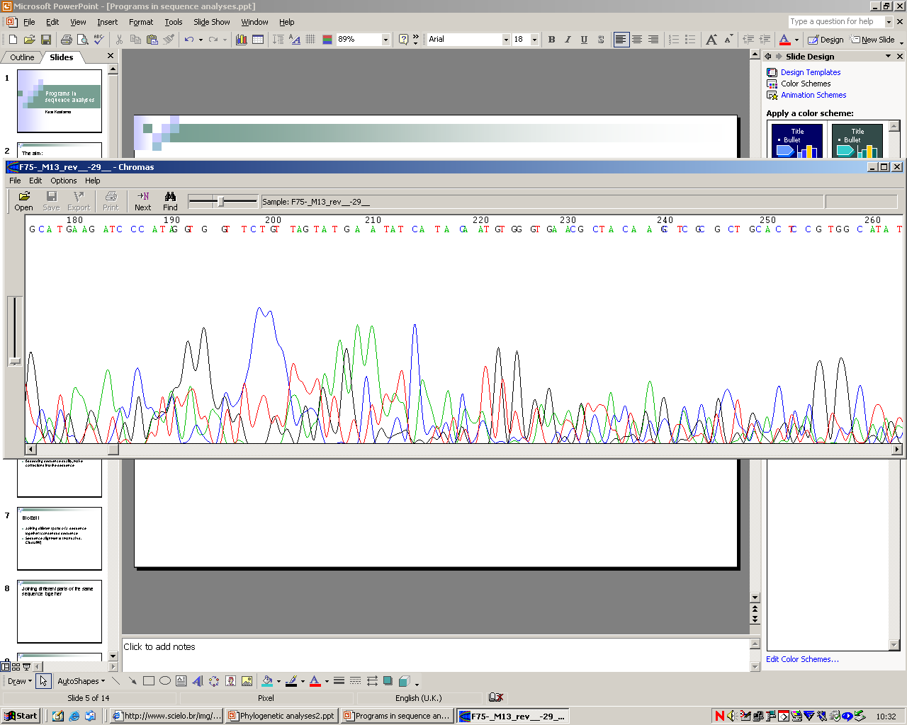
Quality of sequencing data

Slide 19
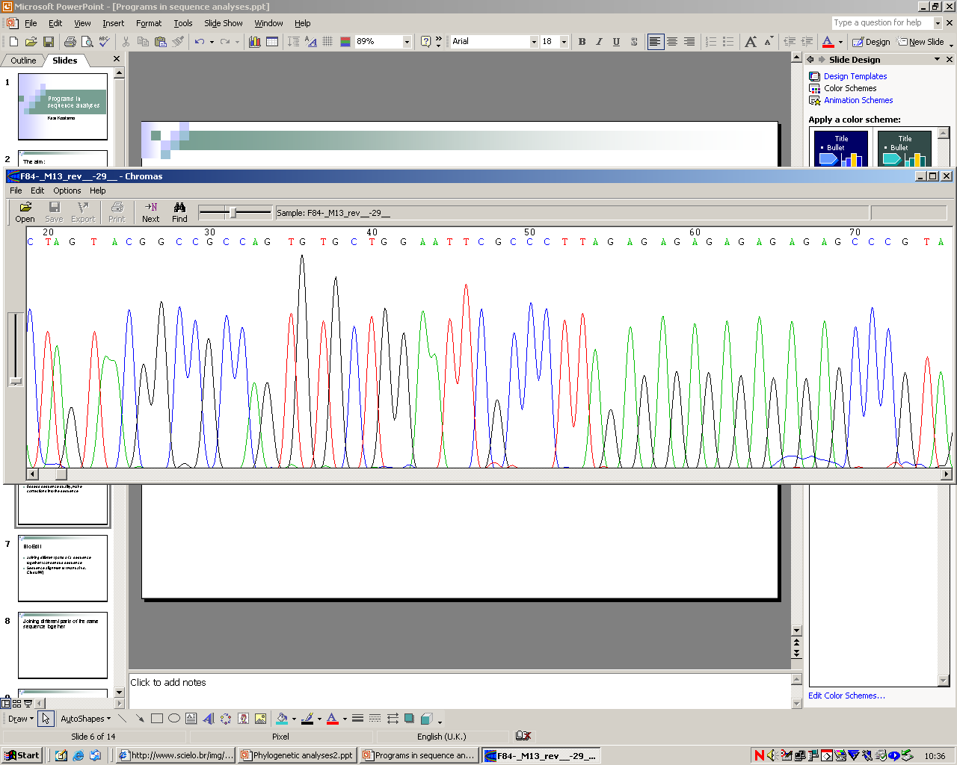
Assessing sequence quality
Chromas
Assess sequence quality, make corrections into the sequence

Slide 20
Two As or only one?

Slide 21
Chromas
Reverse and compliment the sequence
Export sequences in plain text in Fasta, EMBL, GenBank or GCG format
Copy the sequences in plain text or Fasta format into other software applications

Slide 22
BioEdit
Joining different parts of a sequence together (consensus sequence)
Sequence alignments (manual vs. ClustalW)
Alignments up to 20.000 sequences
Export in GenBank, Fasta, or PHYLIP format

Slide 23
Sequence alignment
Finding similar nucleotide composition for further analysis
Manually: can take weeks
ClustalW
Check the alignment made by ClustalW
You may have to go back to Chromas to check the sequences once again

Slide 24
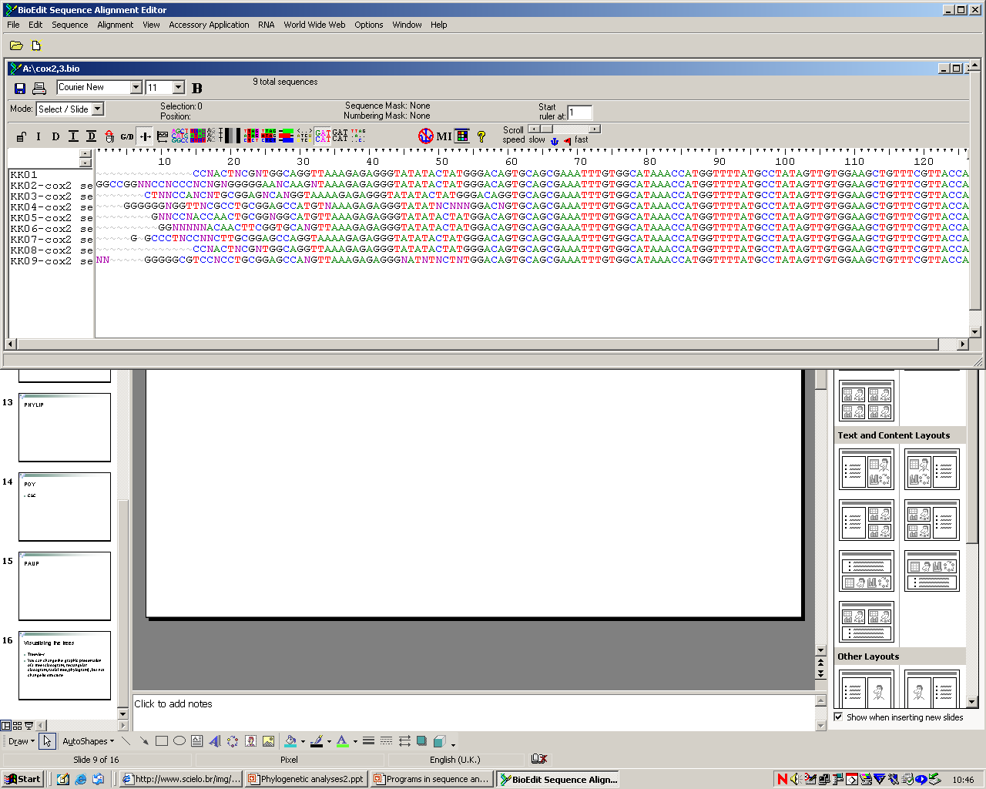

Slide 25
Analysing the aligned sequence matrix
PHYLIP
POY
PAUP, GCG
And many more... (274 software packages described at one website)

Slide 26
PHYLIP (Phylogeny Inference Package)
http://evolution.genetics.washington.edu/phylip.html
Available free in Windows/MacOS/Linux systems
Parsimony, distance matrix and likelihood methods (bootstrapping and consensus trees)
Data can be molecular sequences, gene frequencies, restriction sites and fragments, distance matrices and discrete characters

Slide 27
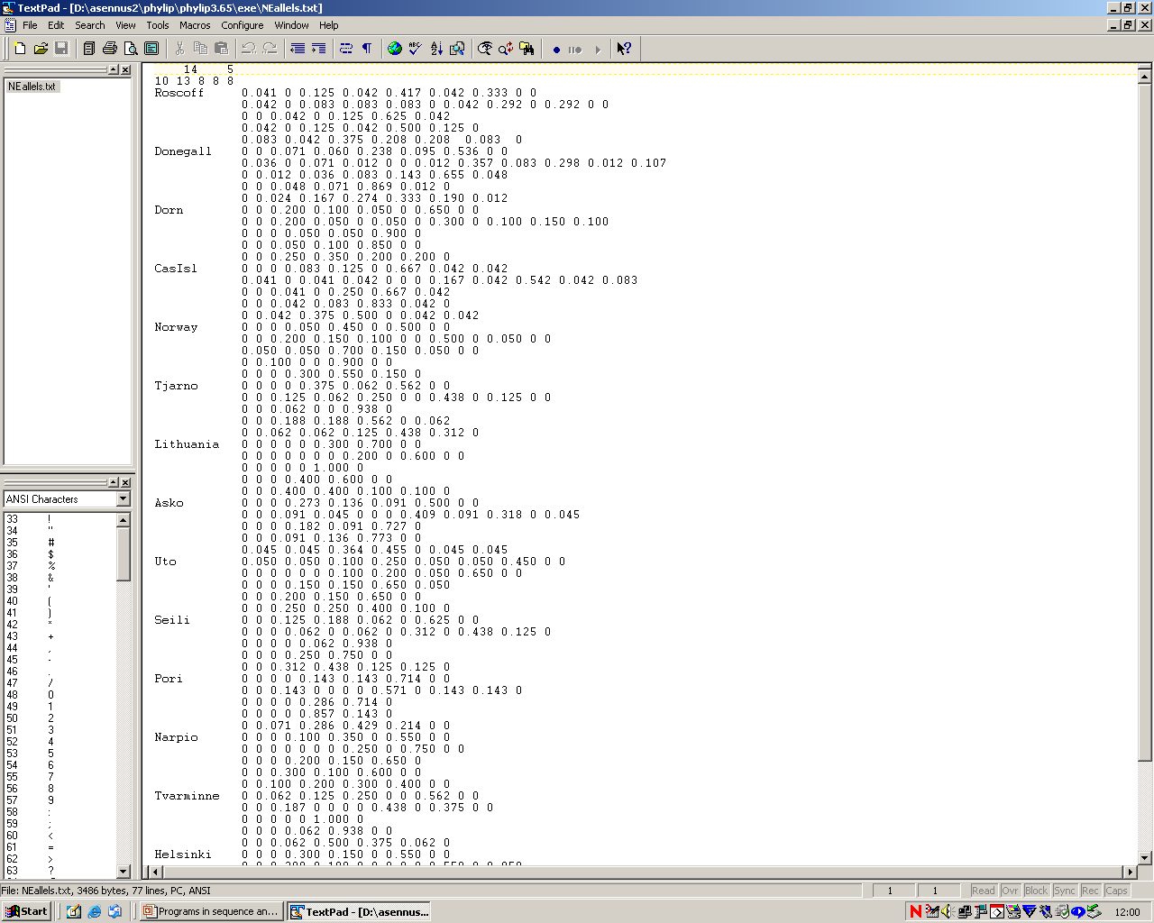

Slide 28
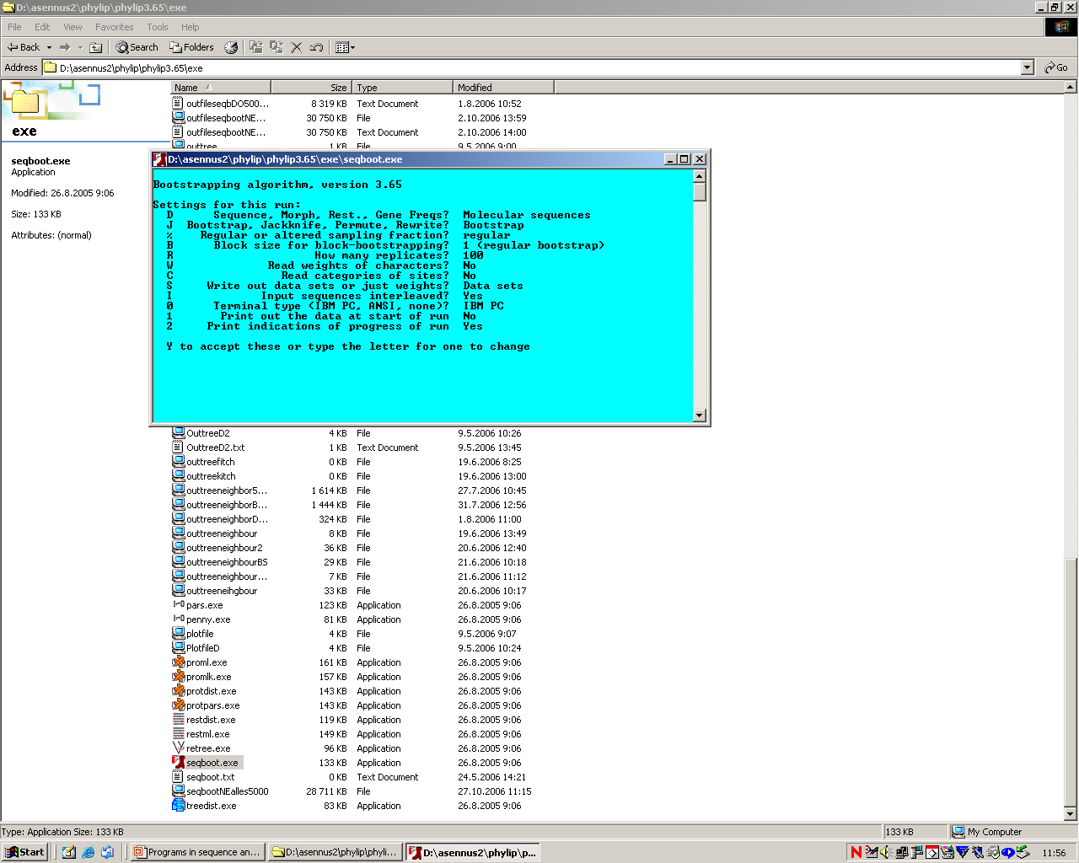

Slide 29
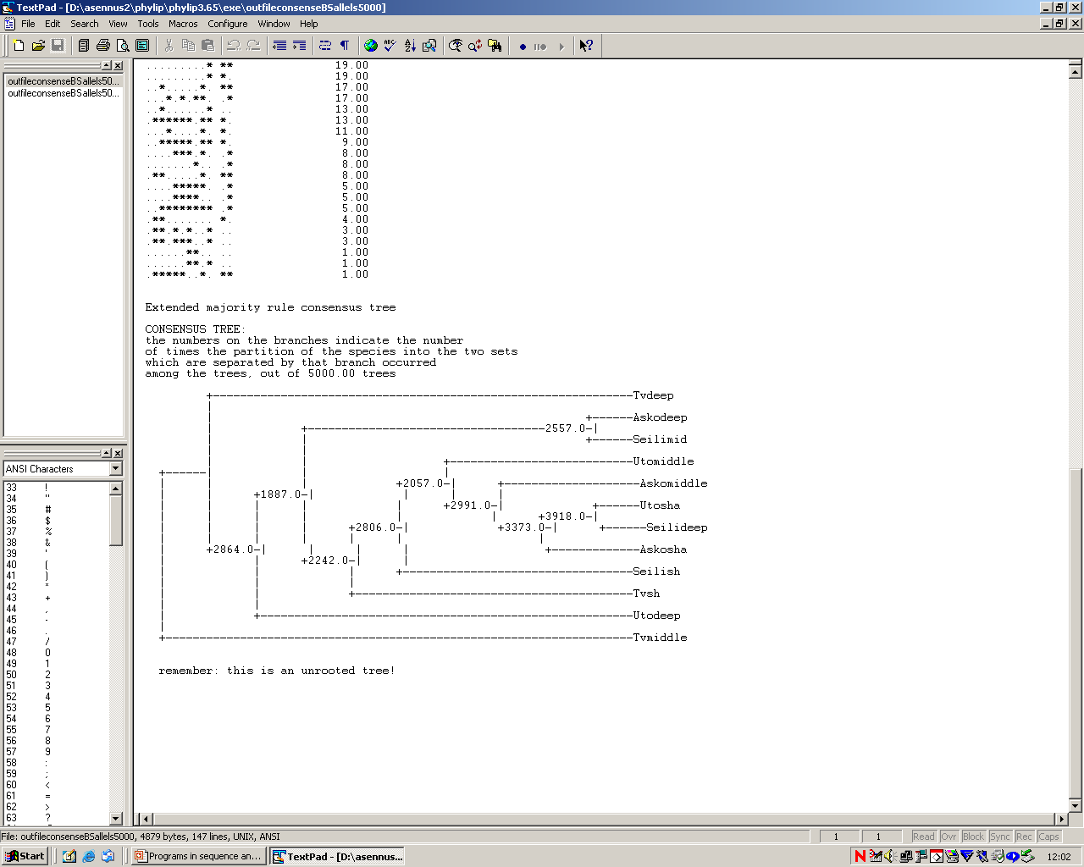

Slide 30
Visualising trees
Treeview
You can change the graphic presentation of a tree (cladogram, rectangular cladogram, radial tree, phylogram), but not change the structure of a tree

Slide 31
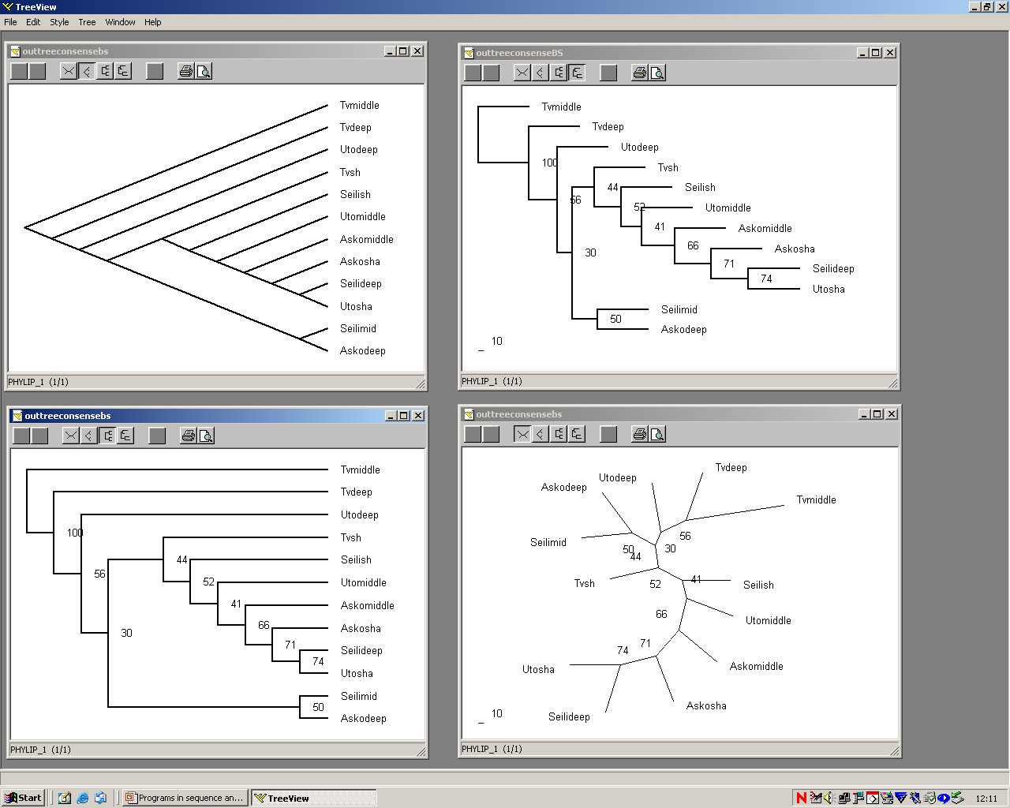

Slide 32
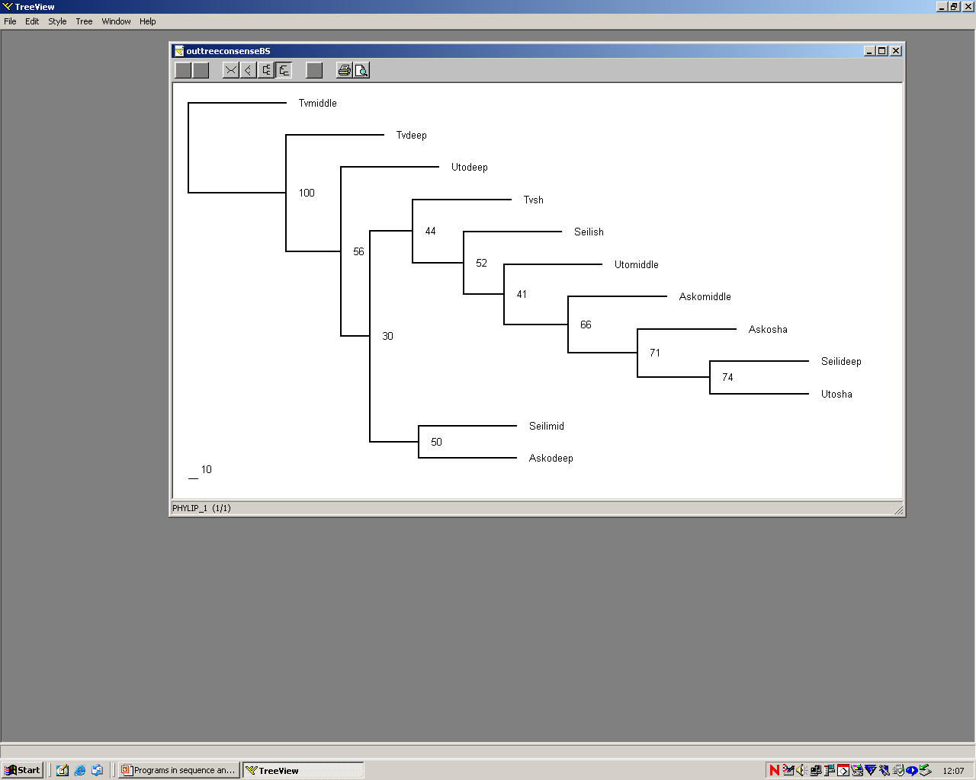

Slide 33
POY
(Phylogenetic Analysis Using Parsimony)
Cladistic and phylogenetic analysis using sequence and/or morphological data
Finding among all possible trees, those that exhibit minimal edit costs (minimum number of mutations)
Is able to assess directly the number of DNA sequence transformations, evolutionary events, required by a tree topology without the use of multiple sequence alignment
CSC

